Slide 1
Swiss Army App
A location-based app that can do (almost) everything
Created by: Team Android 8.0 Oreo
Andrew Chan
Omar Ouf

Slide 2
Overview
The Swiss Army App is an app that triggers user-assigned tasks/actions when in proximity of the pre-defined location.

Slide 3
Programming Goals and Challenges
Goal: To create an app that can detect the user’s location and launch the appropriate user-assigned activities.
Challenges: Our first challenge was to get the maps to work. We found out after a day of testing on various devices that it wouldn't work on the emulator. We also had some initial trouble in deciding how to detect the user’s location and simultaneously trigger an event when in the correct location. Implementing additional functionally required us to read through a lot of references and it usually ended with an error we weren't able to resolve in the time given.

Slide 4
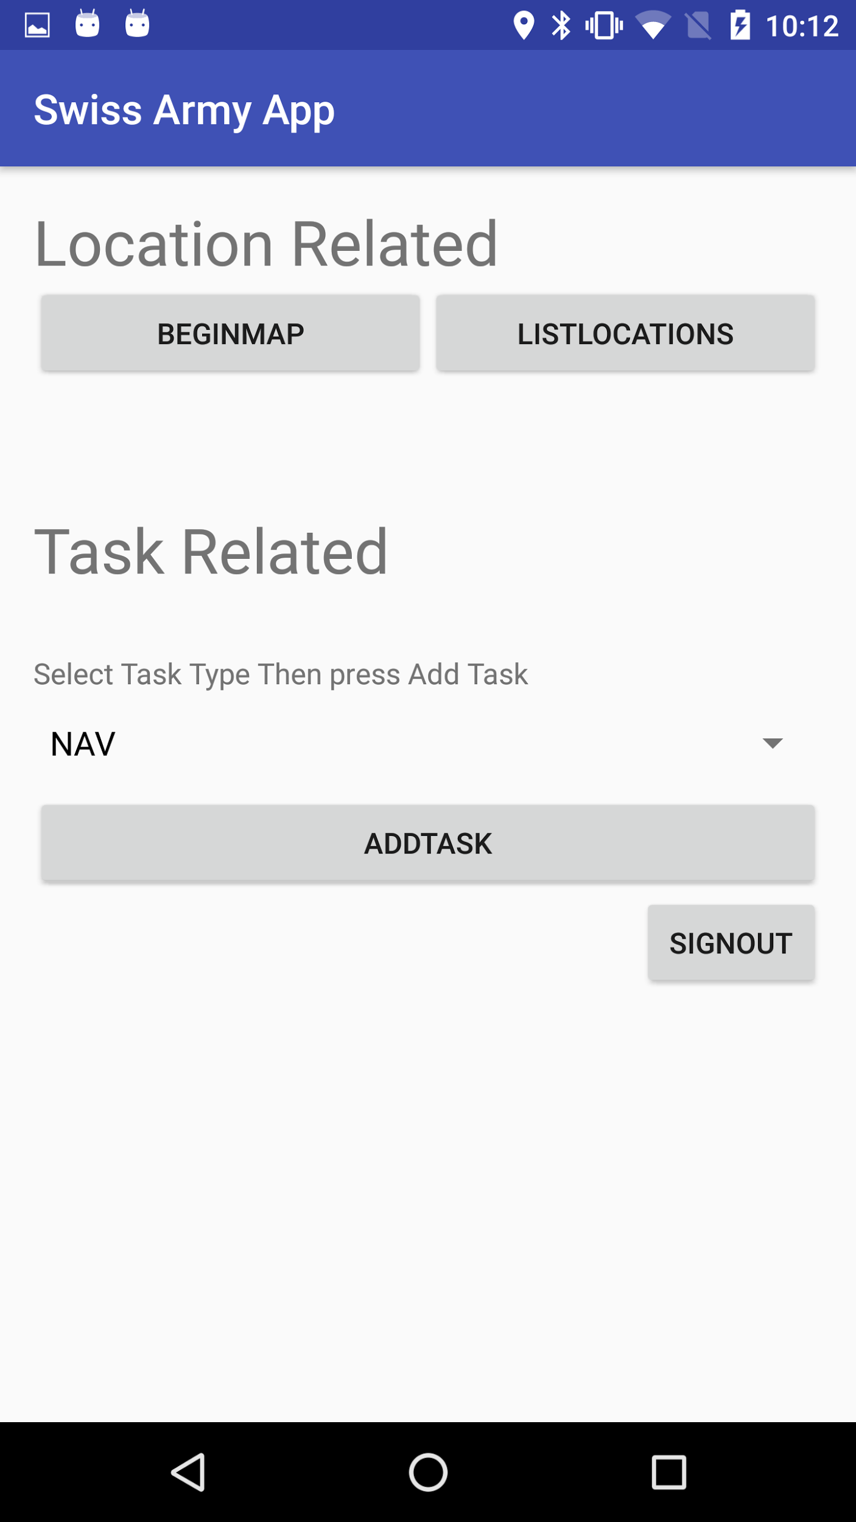
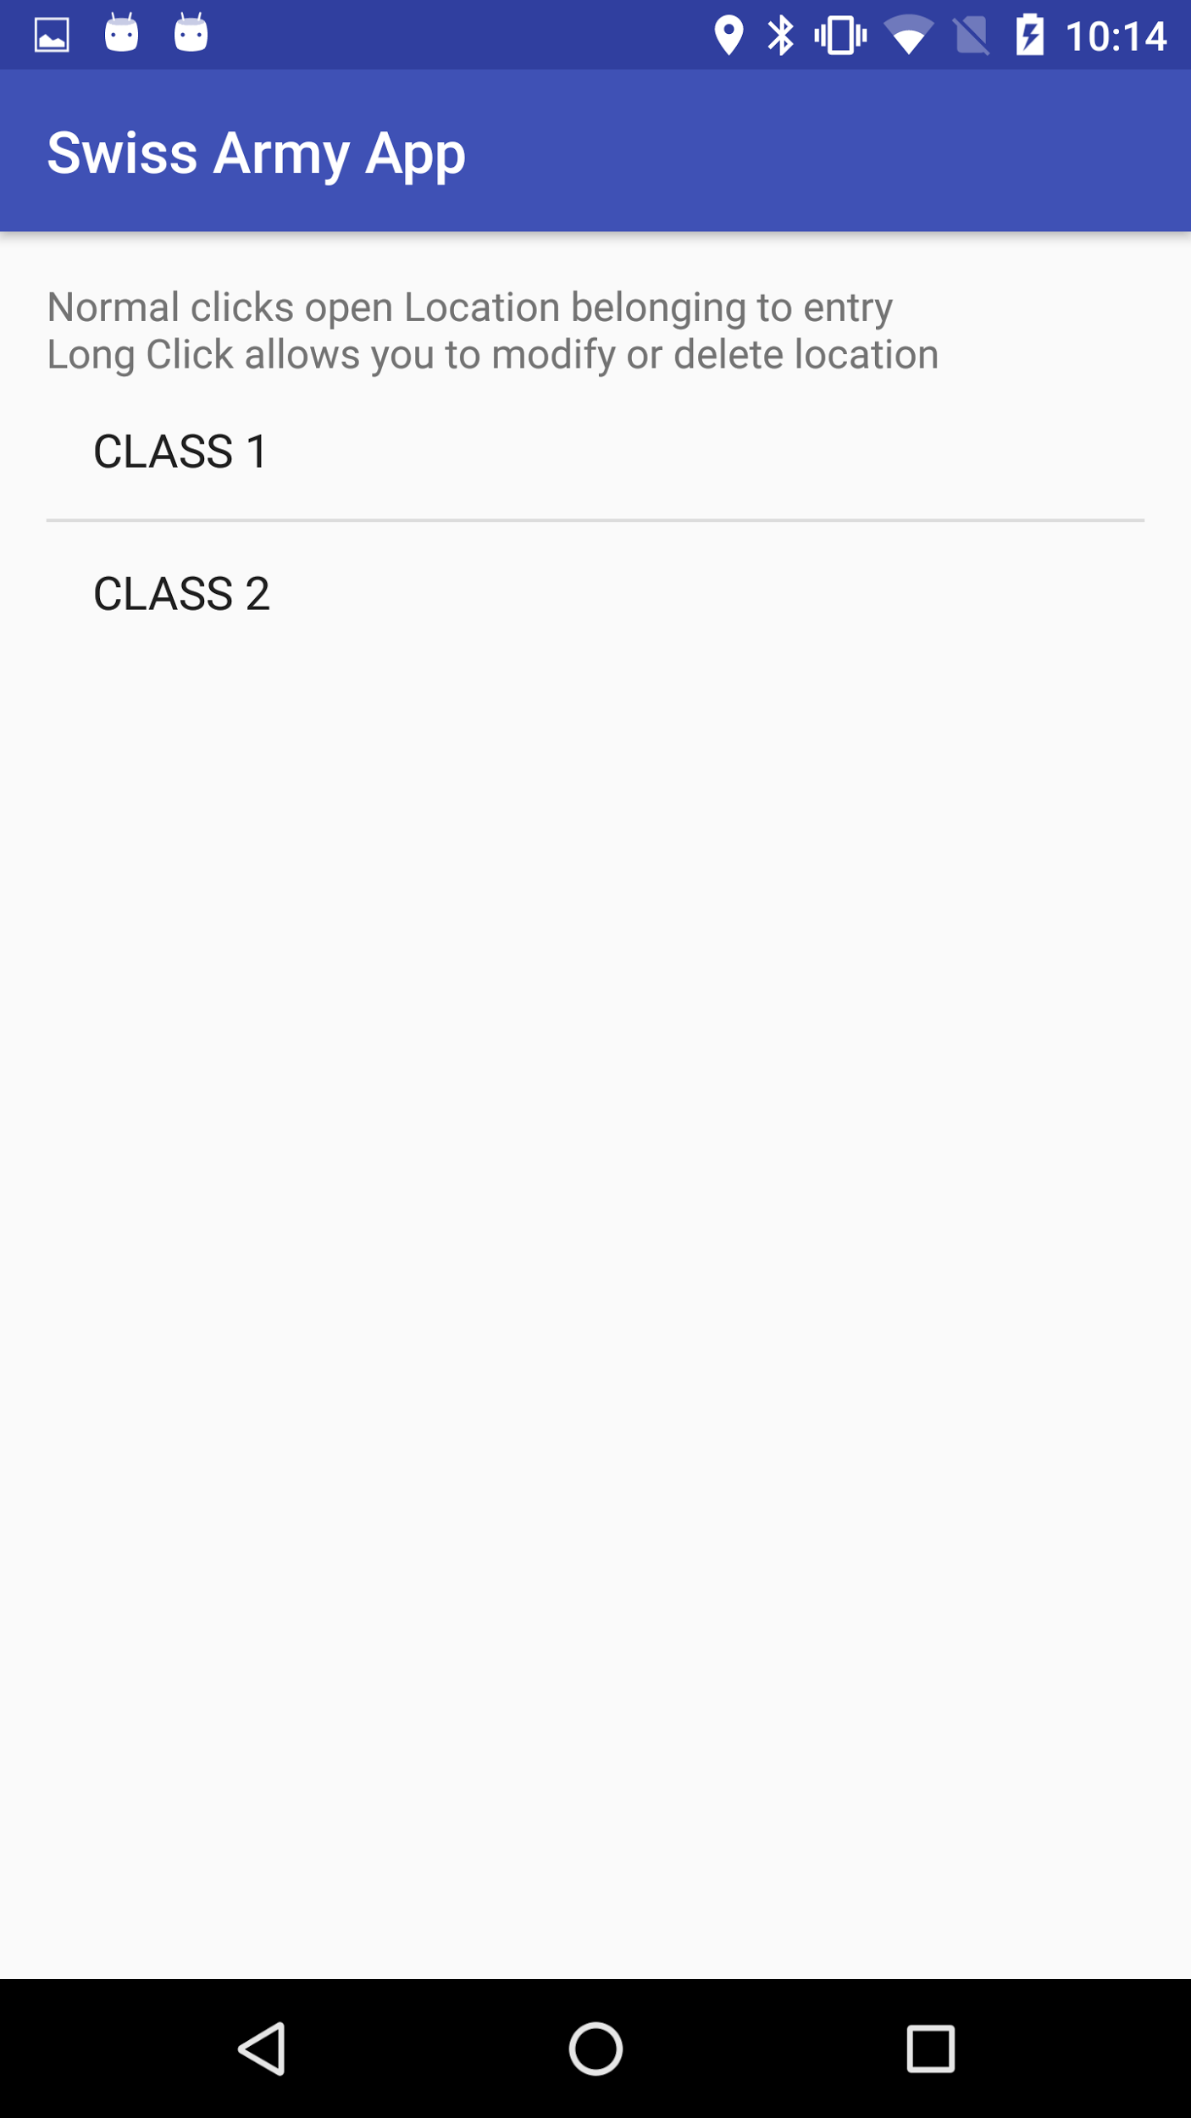
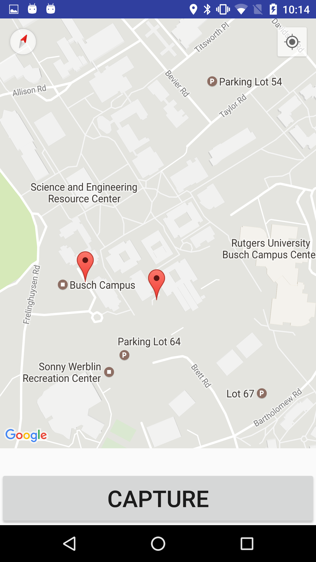
How the App Works
List Locations
Main Activity
Map
Main Activity

Slide 5
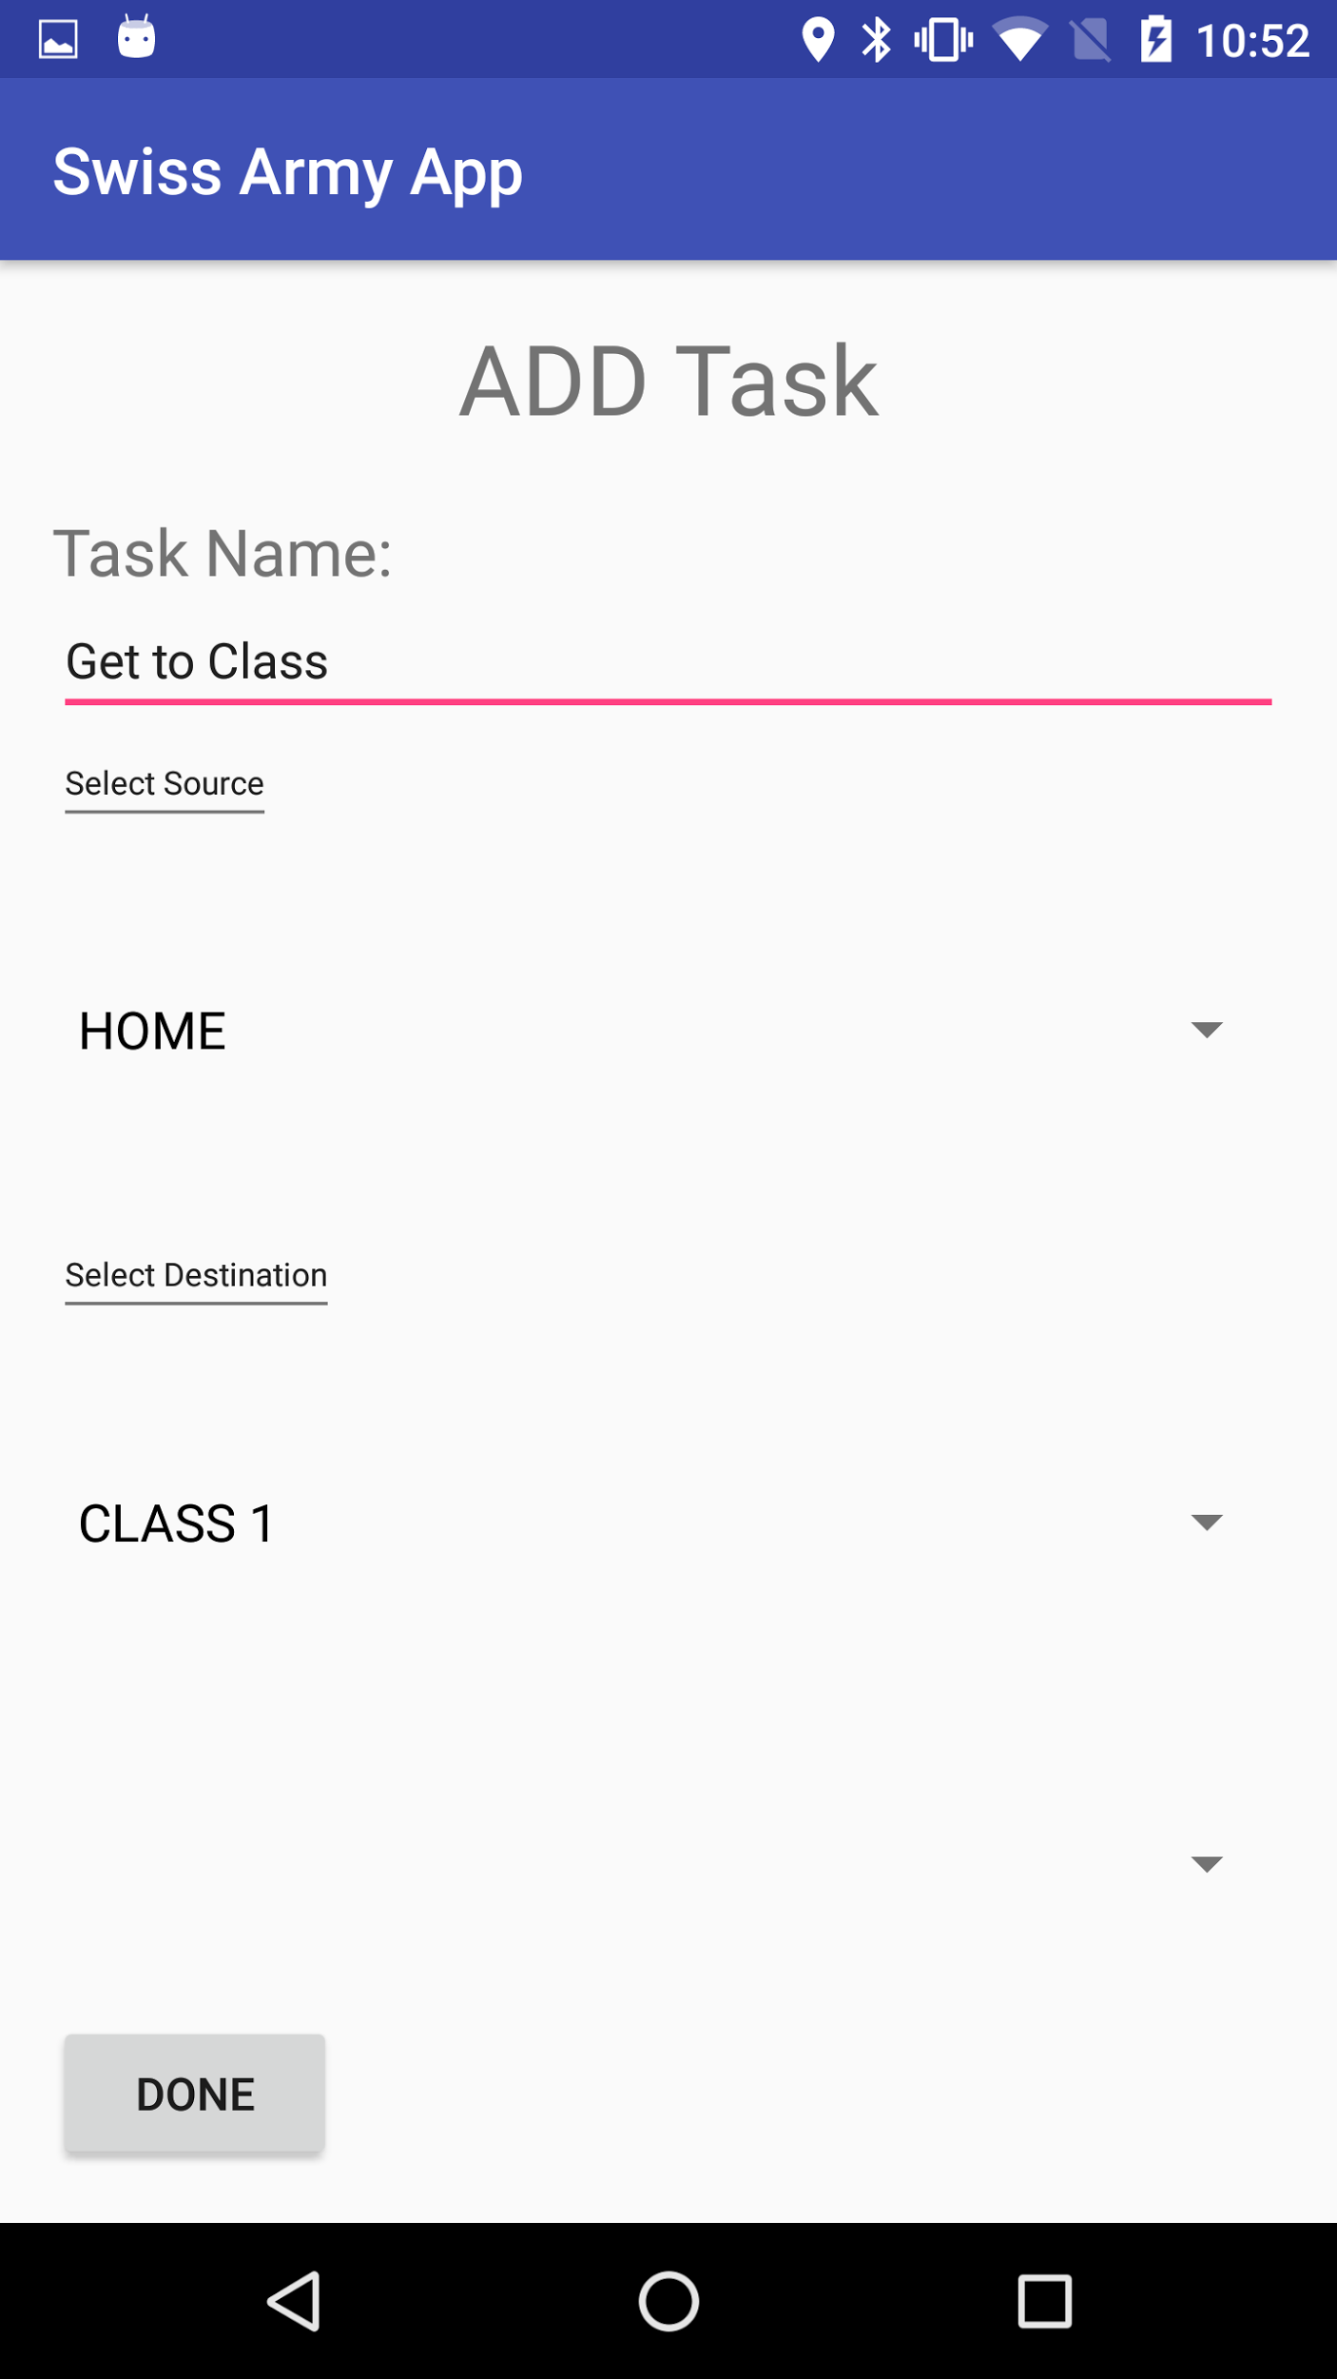
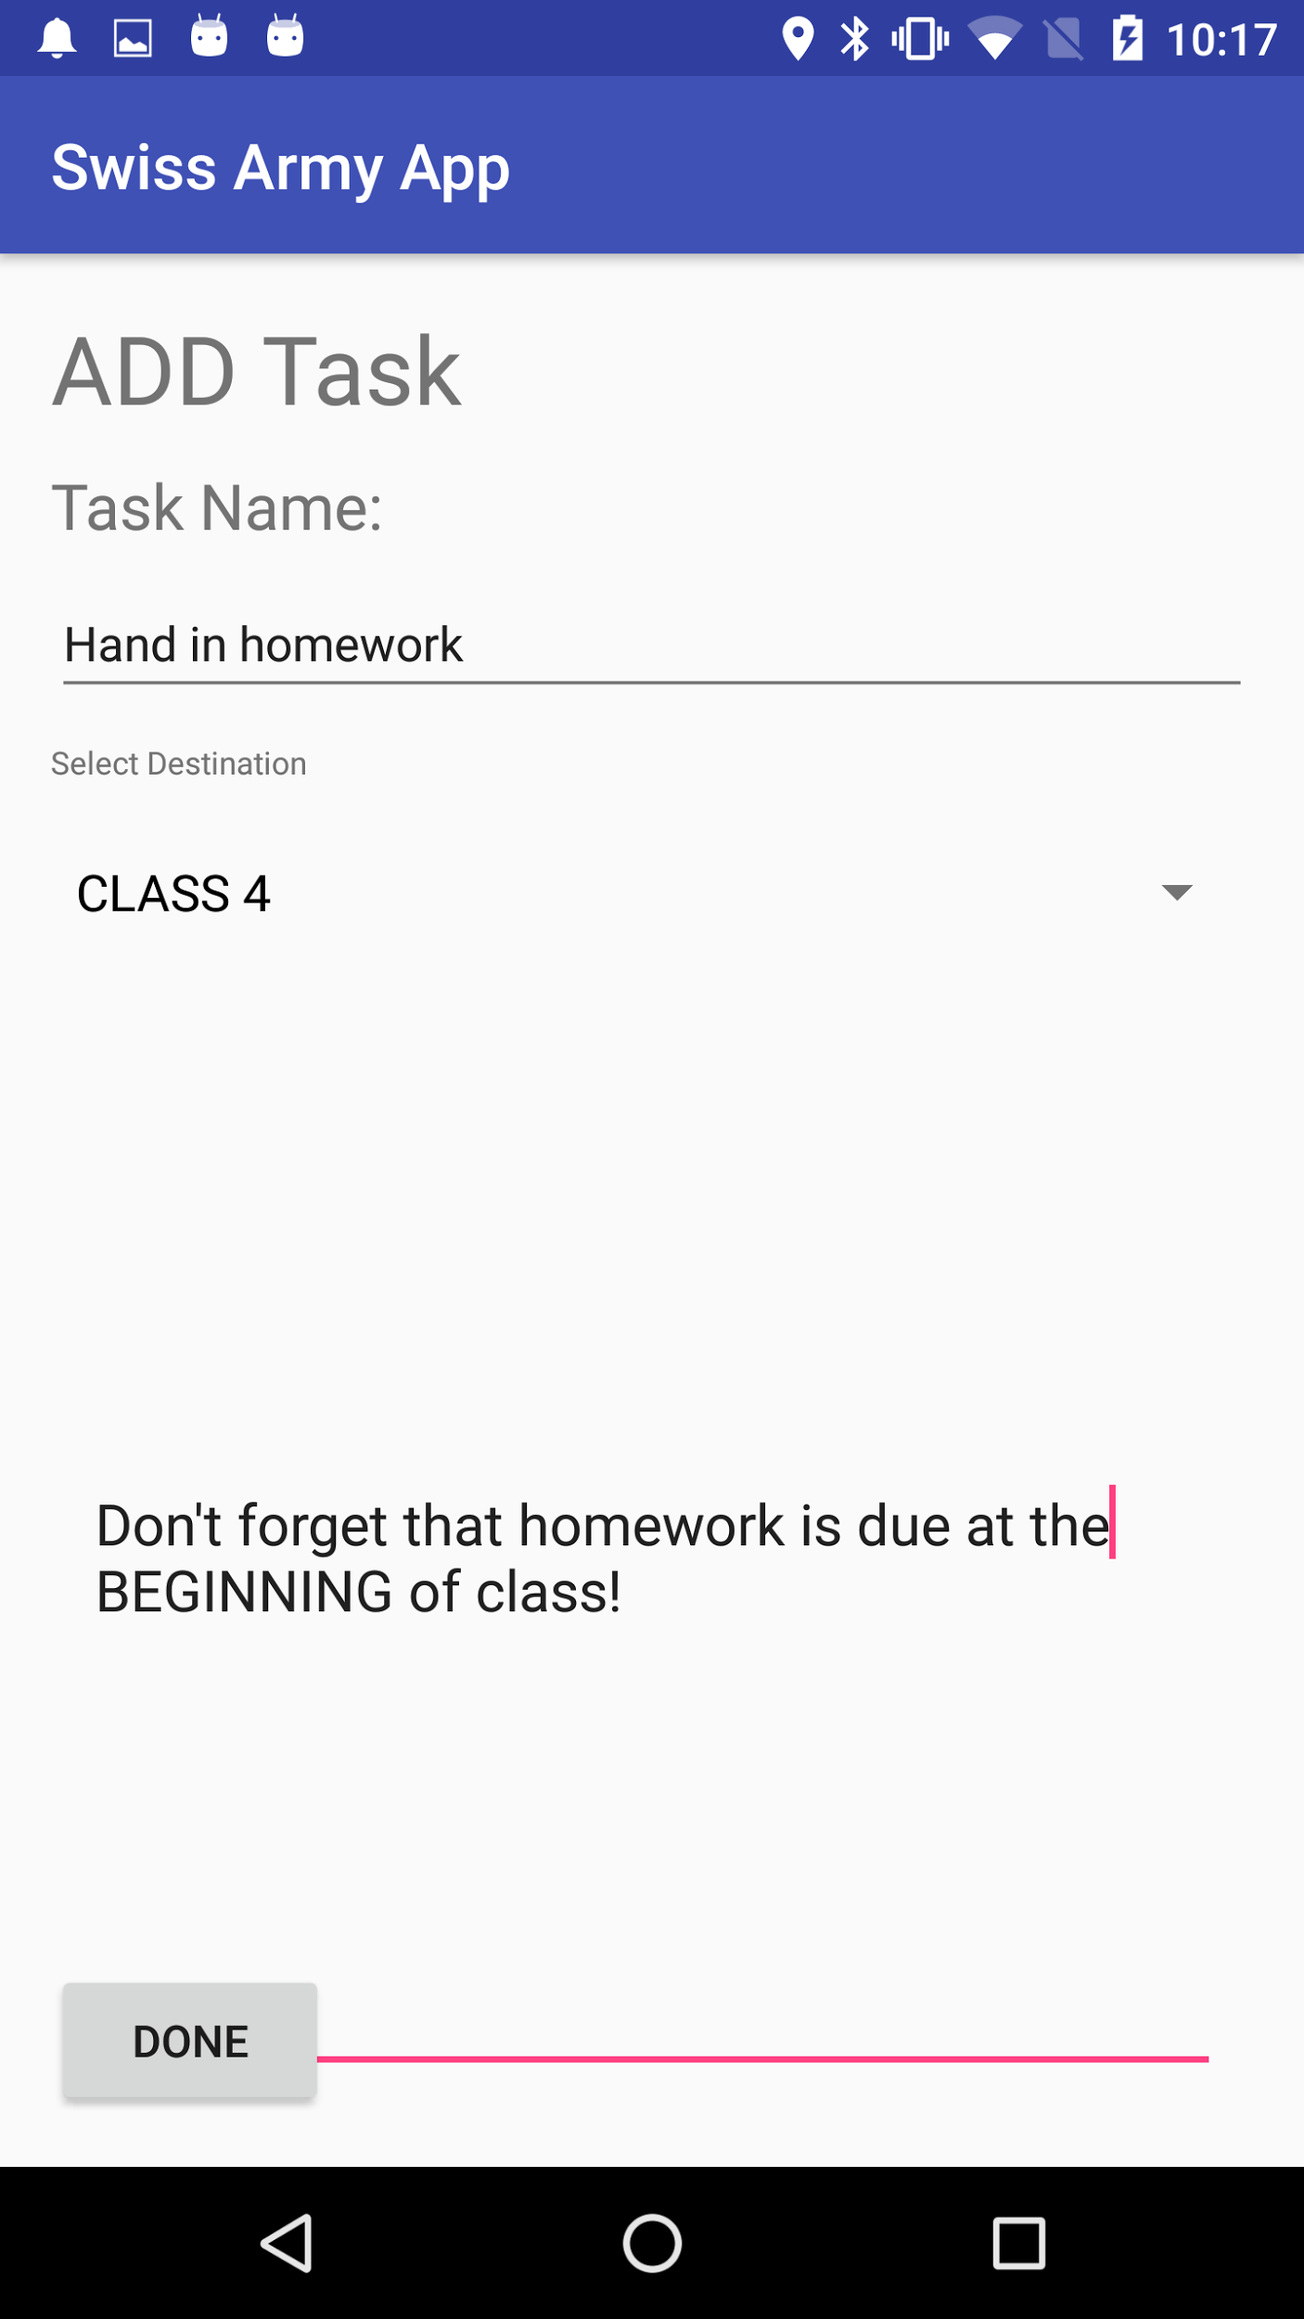
How the App Works
Add Task 1 (Map Directions)
Add Task 2 (Reminder)
Main Activity
Main Activity

Slide 6
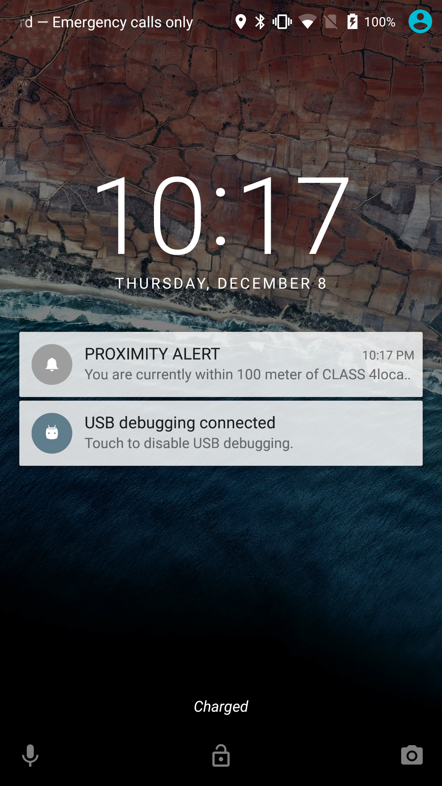
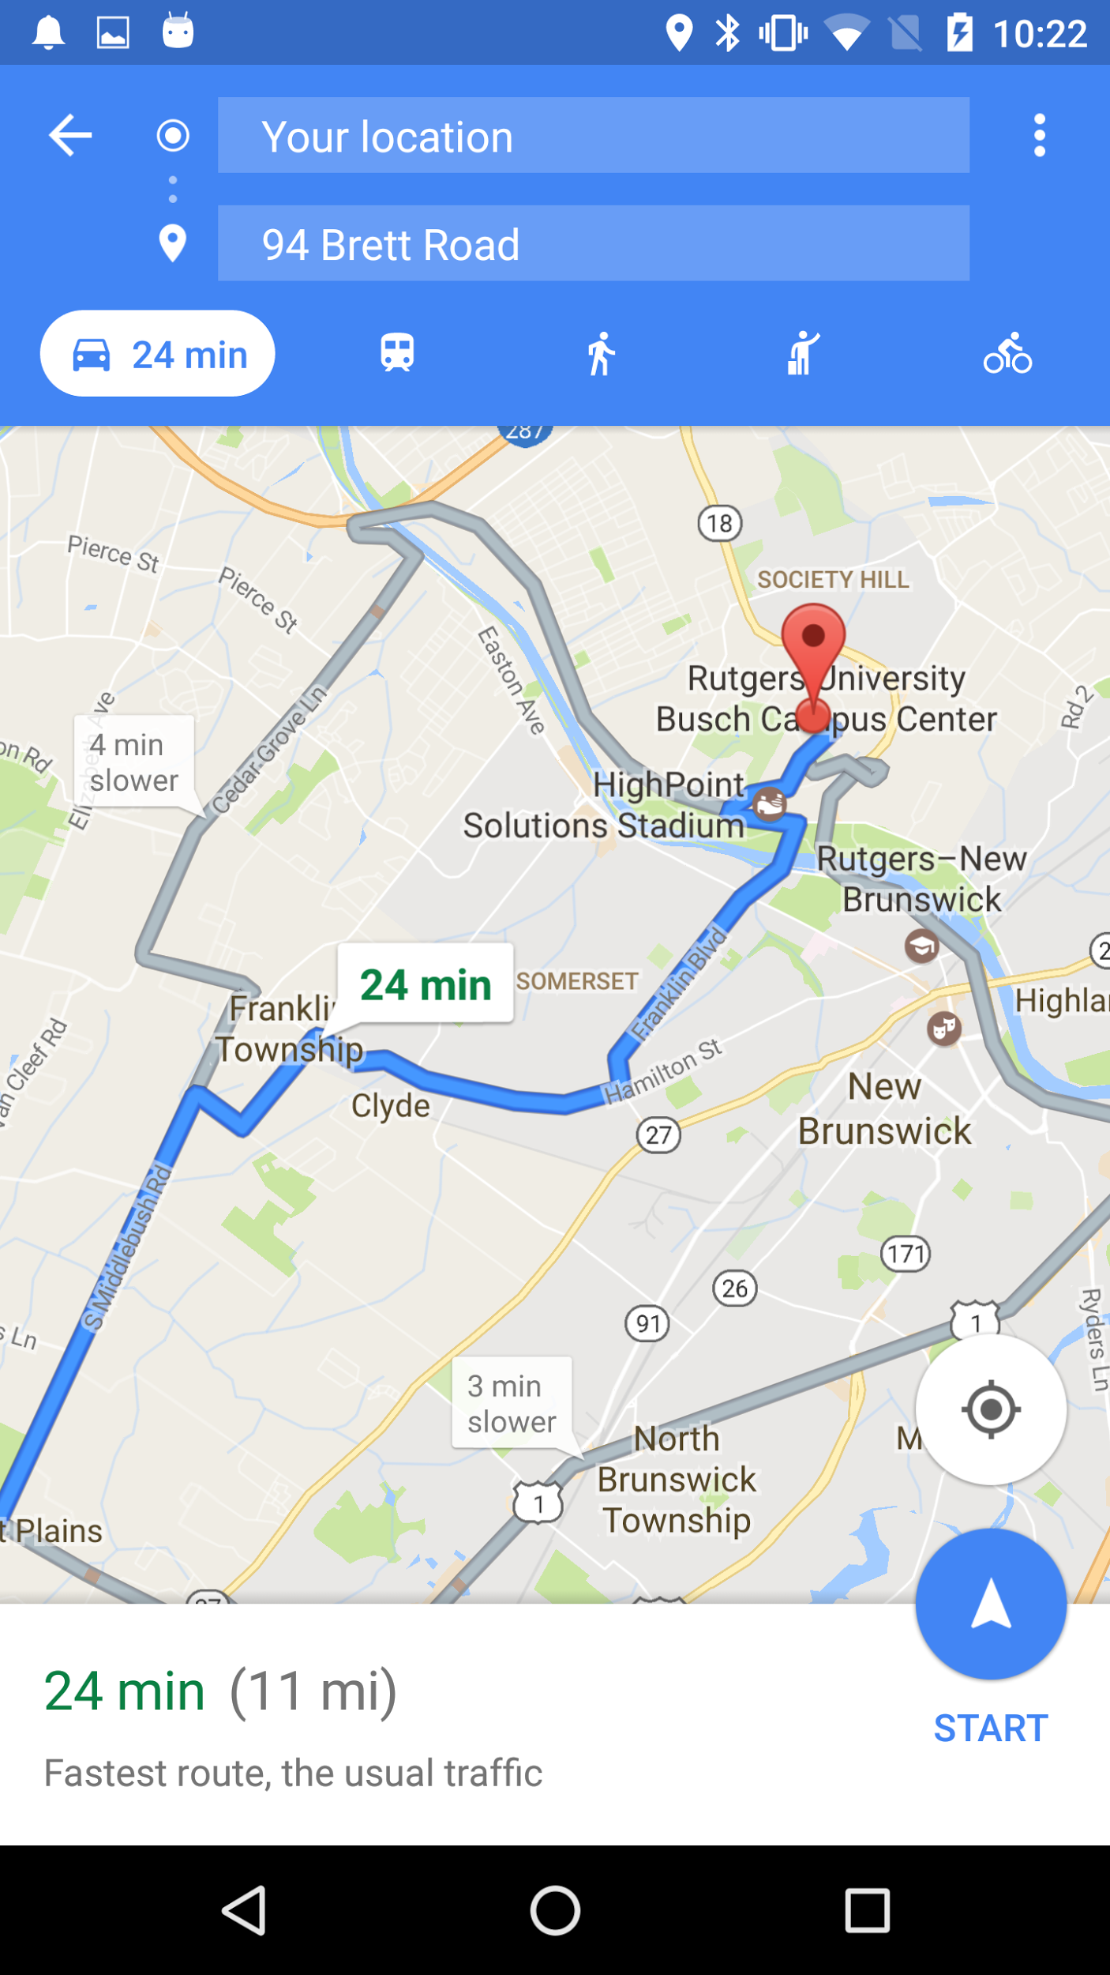
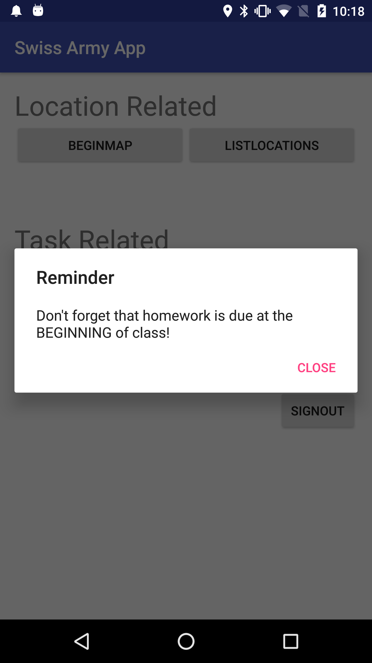
How the App Works
In Proximity
Launch Task 1 (Map Directions)
Launch Task 2 (Reminder)

